Slide 1
KIDNEY DISEASE ANALYSIS
Submitted by:
Sushniv Vangari
K. Hrushikesh Koundinya
B. Varun Kumar
S. Sri Ram
K. Sai Gurunadh

Slide 2
WHAT IS MACHINE LEARNING?

Slide 3
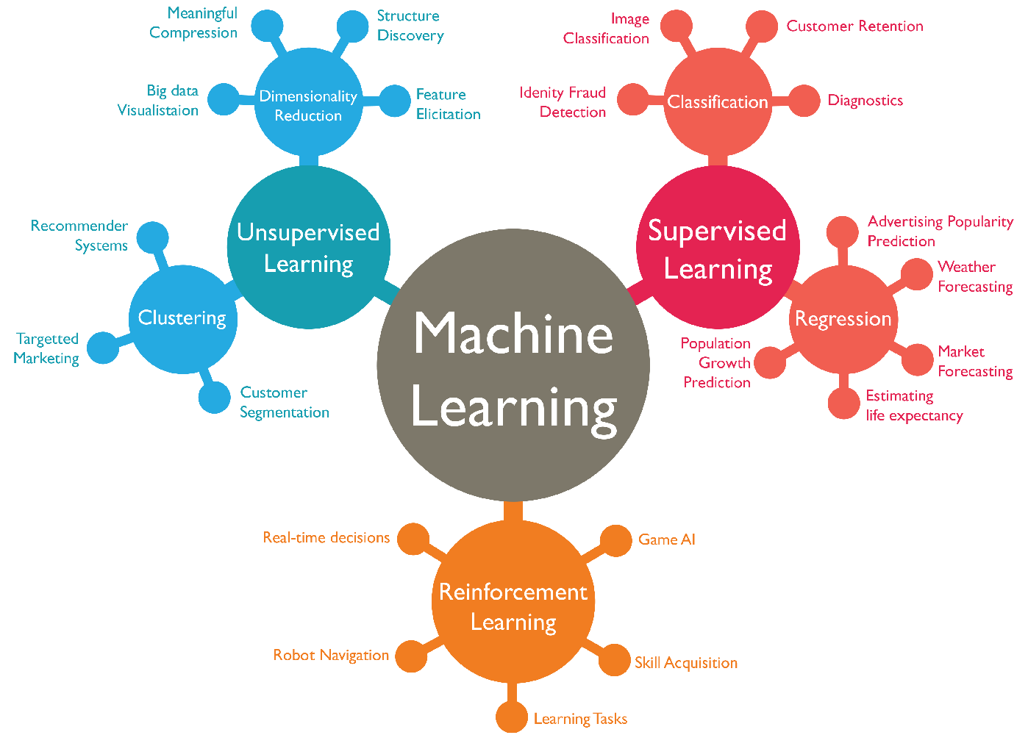

Slide 4
APPLICATIONS IN DAY–TO-DAY LIFE
Social media services
E-mail spam
Online customer support
Product recommendation
Online fraud detection
Weather reporting
Medical Analysis

Slide 5
Project data set:- The data set is based on implementation of kidney disease analysis project that builts the measuring accuracy by the help of Machine learning.
Features:-
Id-id
Age-age
Bp-Blood pressure
Sg -Specific gravity
Al-Albumin
Su-Sucrose
Pc- Polycystic
Pcc- Pheochromocytoma
Bgr- Blood glucose random
Bu- Blood urea
Sc- Serum creatinine concentration
Sod- Superoxide dismutase
Pot- Postural orthostatic tachycardia
Hemo- Hemoglobin
Pcv- Packed cell volume
Wc- Waist circumference
Rc- Renal corticomedullary
Htn- Hypertension
Dm- Damage blood vessels
Cad- Coronary artery disease
Appet-Appetite
Pe- Pulmonary embolism
Ckd-Chronic kidney disease

Slide 6
Packages Imported
Numpy
Pandas
Seaborn
Matplotlib
Sklearn(Logistic Regression, SVC, Decision Tree Classifier,
Random Forest Classifier)

Slide 7
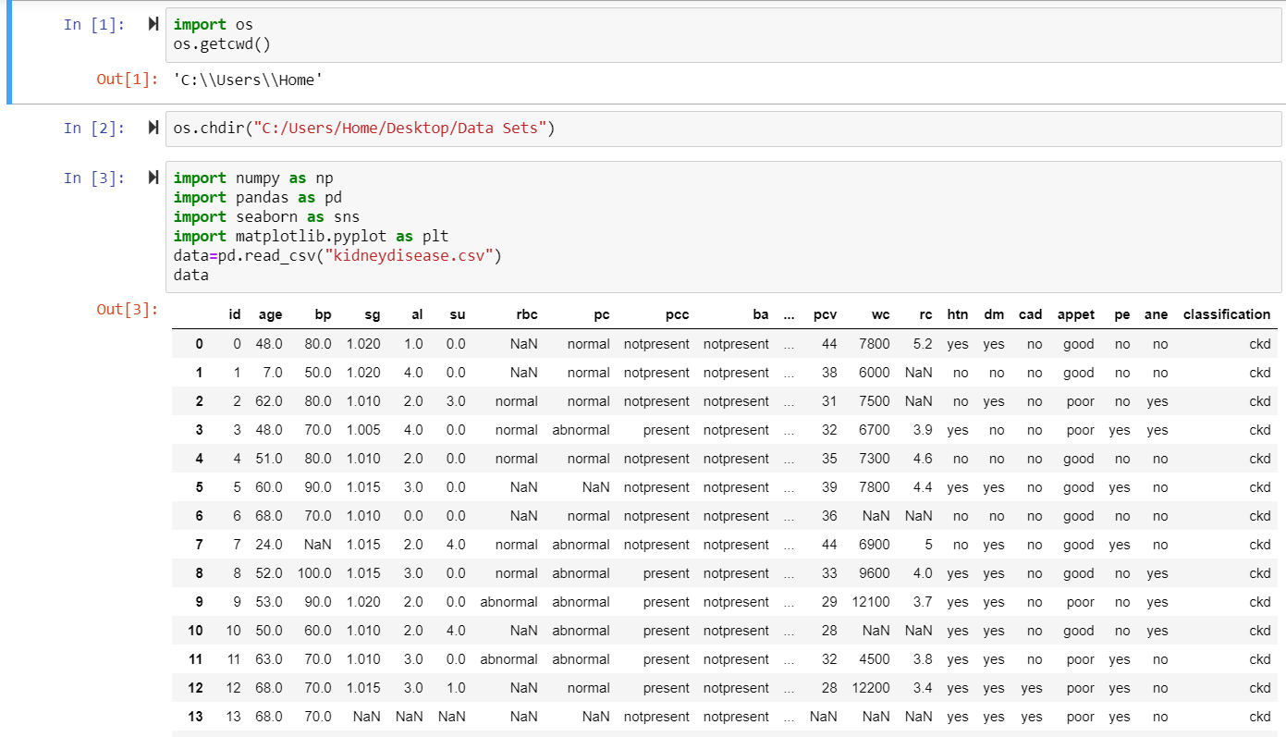
Importing The Data Set from csv file using pandas and numpy.
There are 400 rows and 26 columns initially.

Slide 8
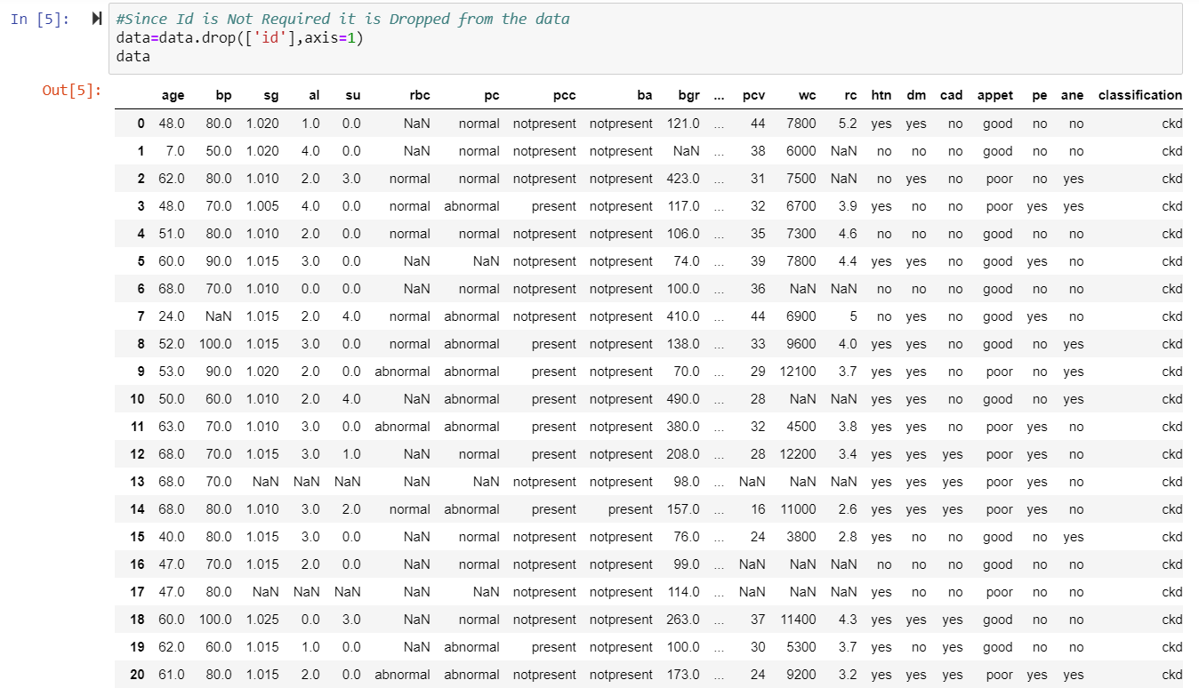
There are some missing values so we should clean the data “id” doesn’t effect presence of kidney disease, so we are dropping it.

Slide 9
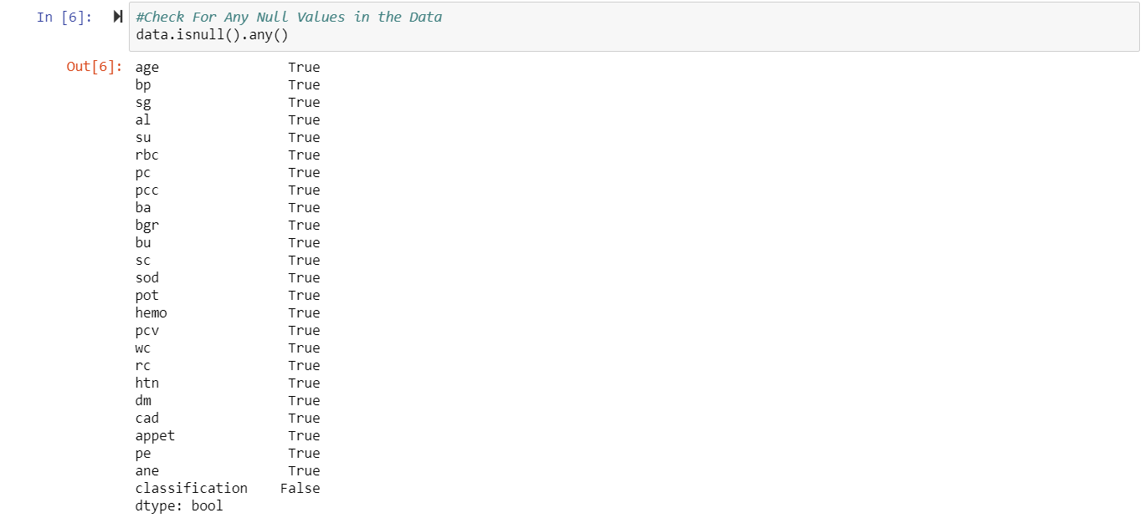
The Data Set is checked for Null values
If Null Values are Present ,the Output is True.
If Null Values are Absent ,the Output is False.

Slide 10
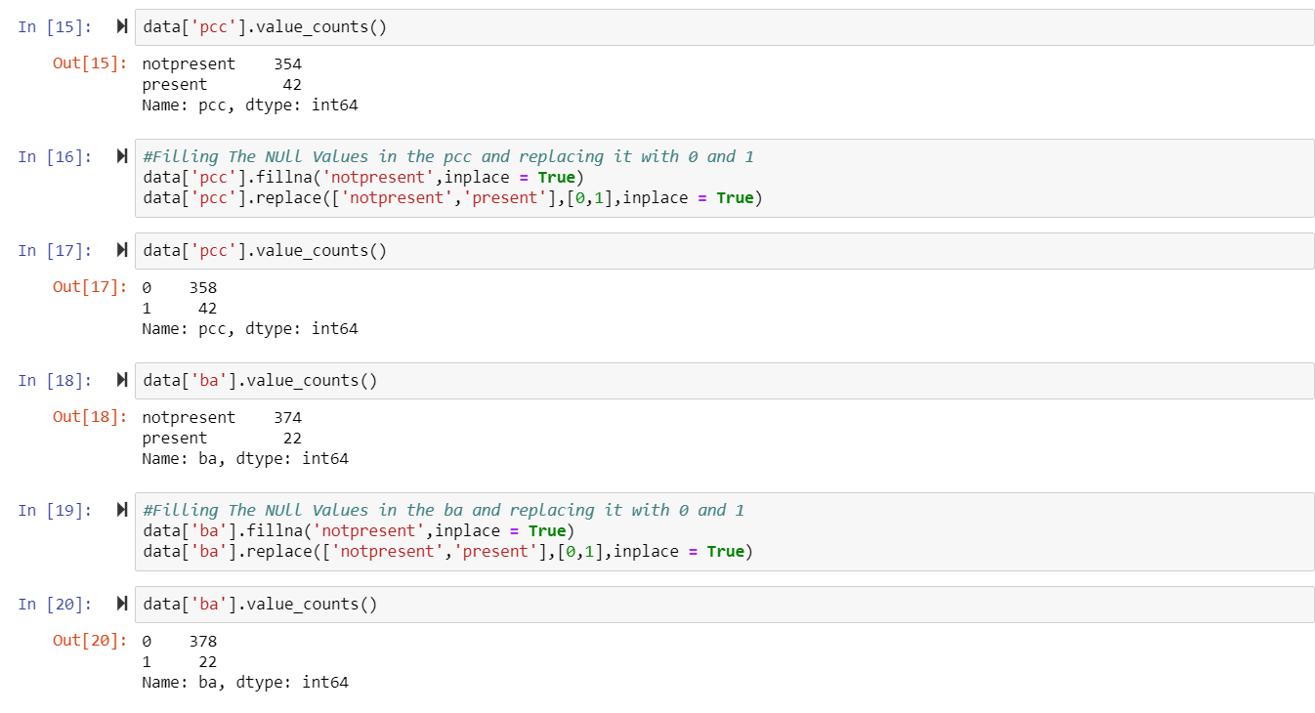
Converting string into integers
The given dataset contain strings we are changing into integers
Classification is target and remaining features are predictors
The dataset containing string values we are changing into the integers by giving the Notpresent=0(True),Present=1(False) And counting values in a dataset and we are doing for remaining features also as the same done for the pcc.

Slide 11
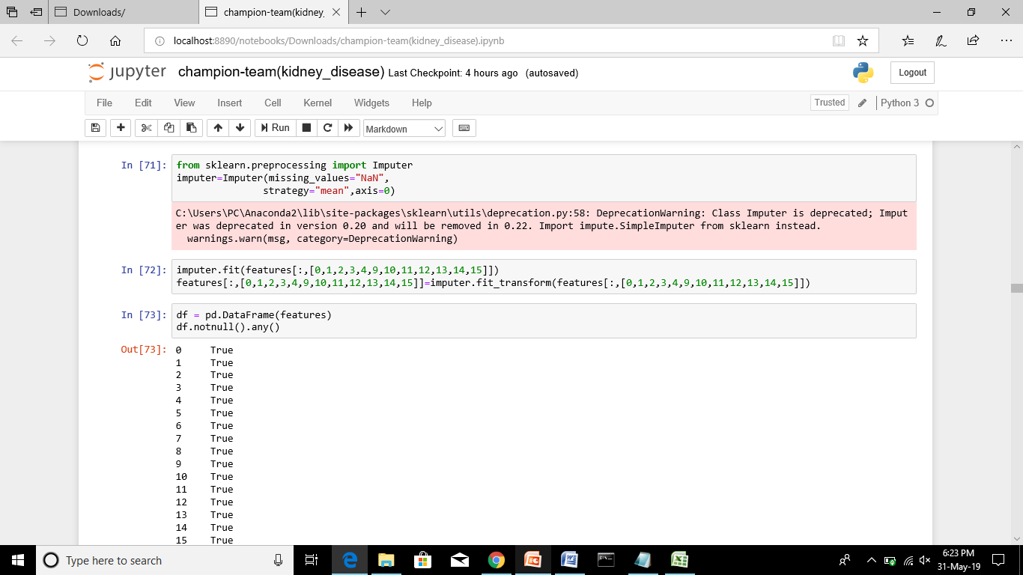
Cleaning the features values containing “NaN“ values on the given dataset and checking the null values whether data contain any null values. Imputation Technique is used to fill all the null values present in Numerical Columns.

Slide 12
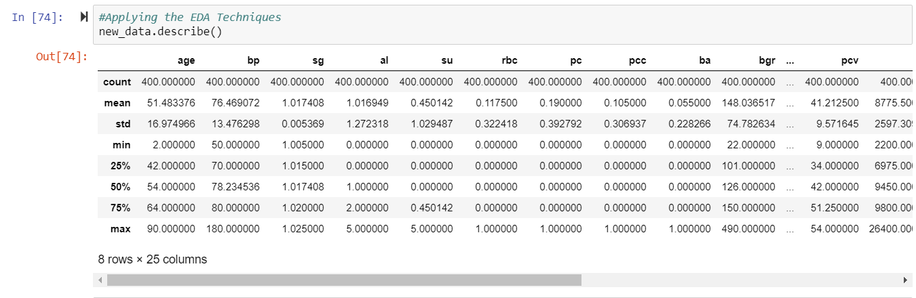
Final Data Set
The Final Data set is cleaned data which is free from all missing values.
Describe command is used to get the stastical data like mean , std, percentile etc

Slide 13
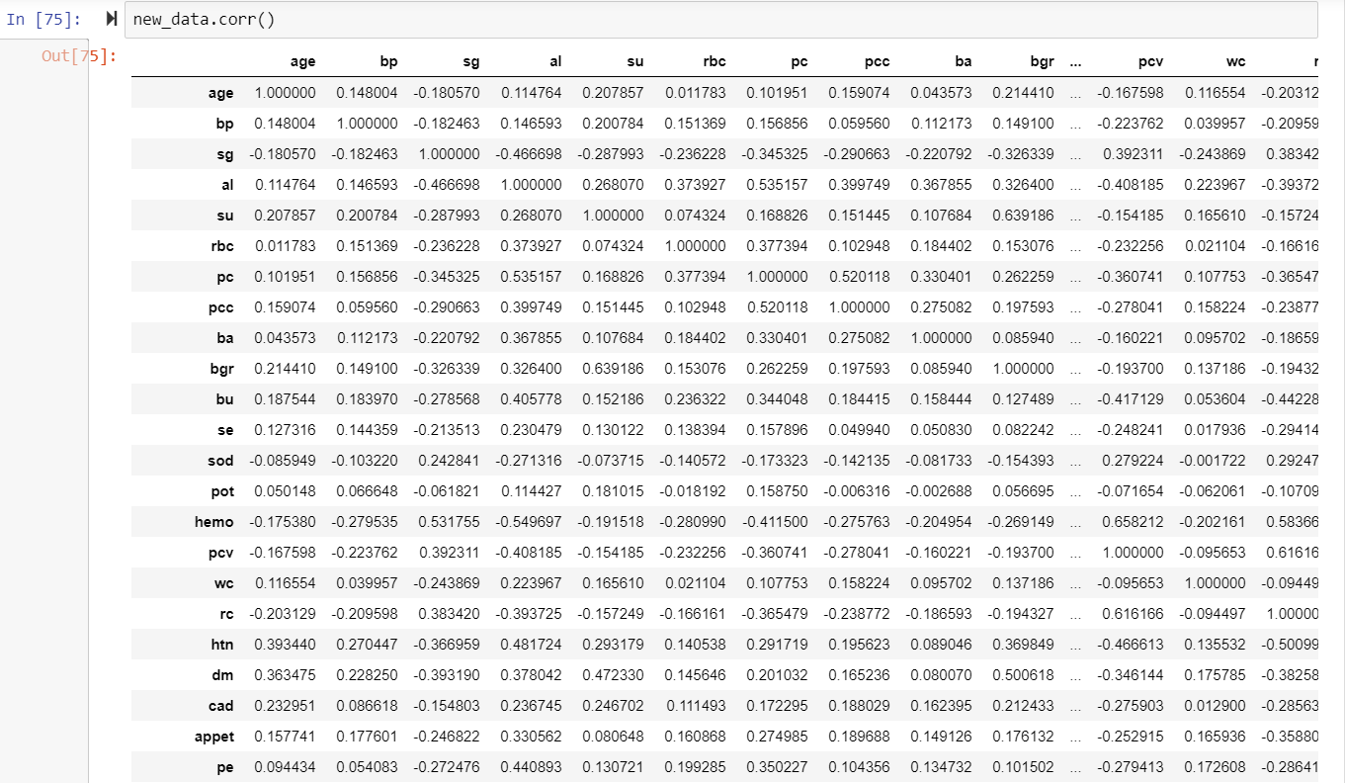
Correlation:

Slide 14
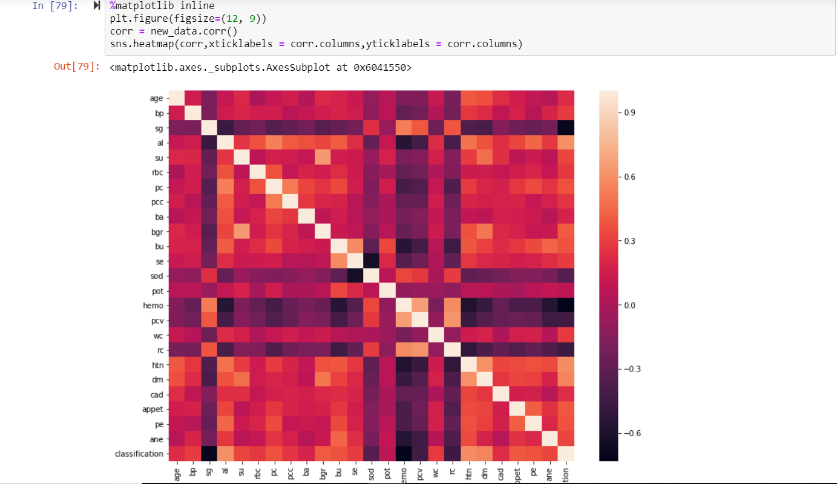
HEAT MAP ANALYSIS
According to Heat Map It can Be Observed that sg,sod,hemo,pcv,rc are negeatively correlated with classification.(i.e With their increase disease decreases).
al,htn,dm are positively Correlated With Classification.(i.e With their increase disease increases)

Slide 15
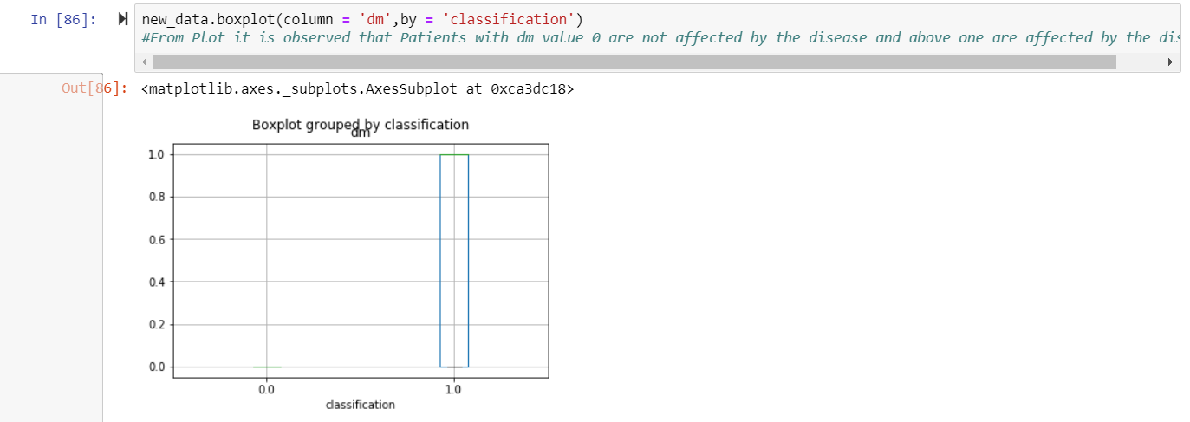
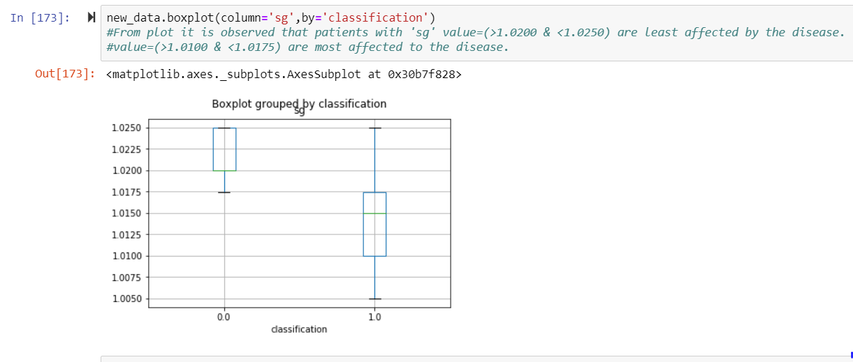
Box plots

Slide 16
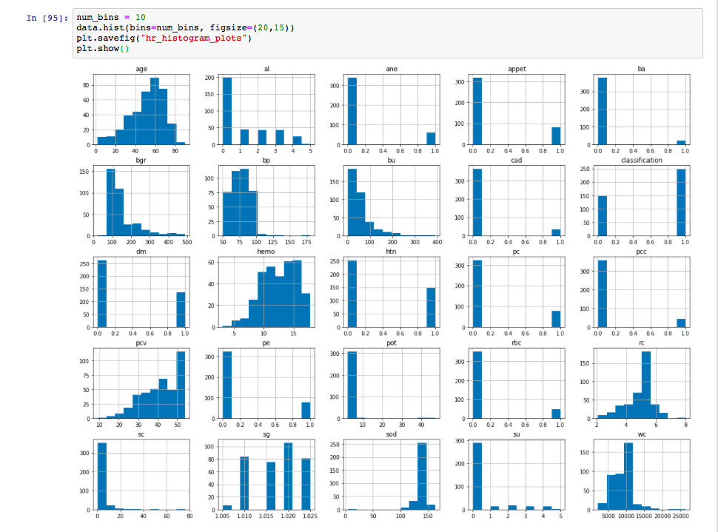
Histograms Plots

Slide 17
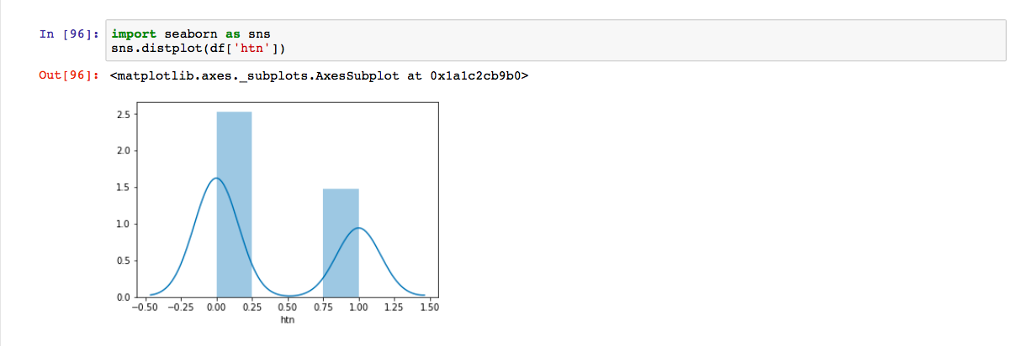
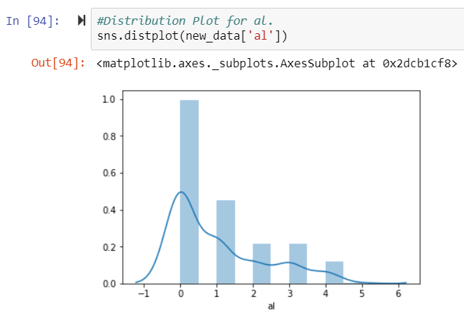
DISRIBUTION PLOTS

Slide 18
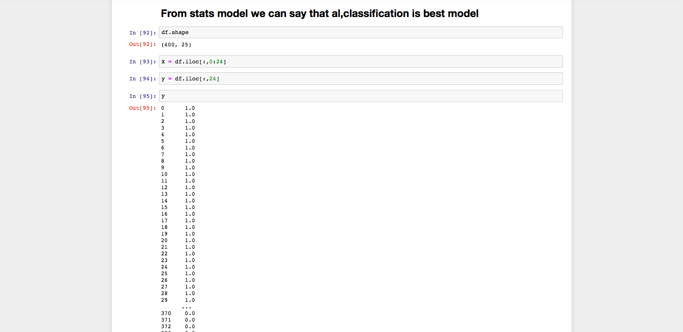
Input variables and Target values are assigned

Slide 19
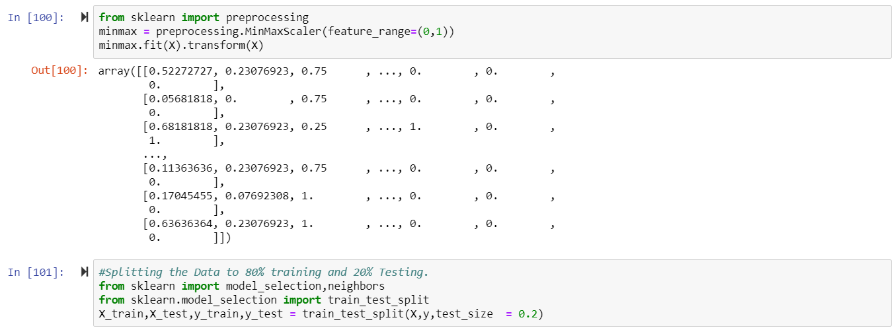
Normalization of Data
Normalization of data normalization refers to rescaling real valued numeric attributes into the range 0 and 1

Slide 20
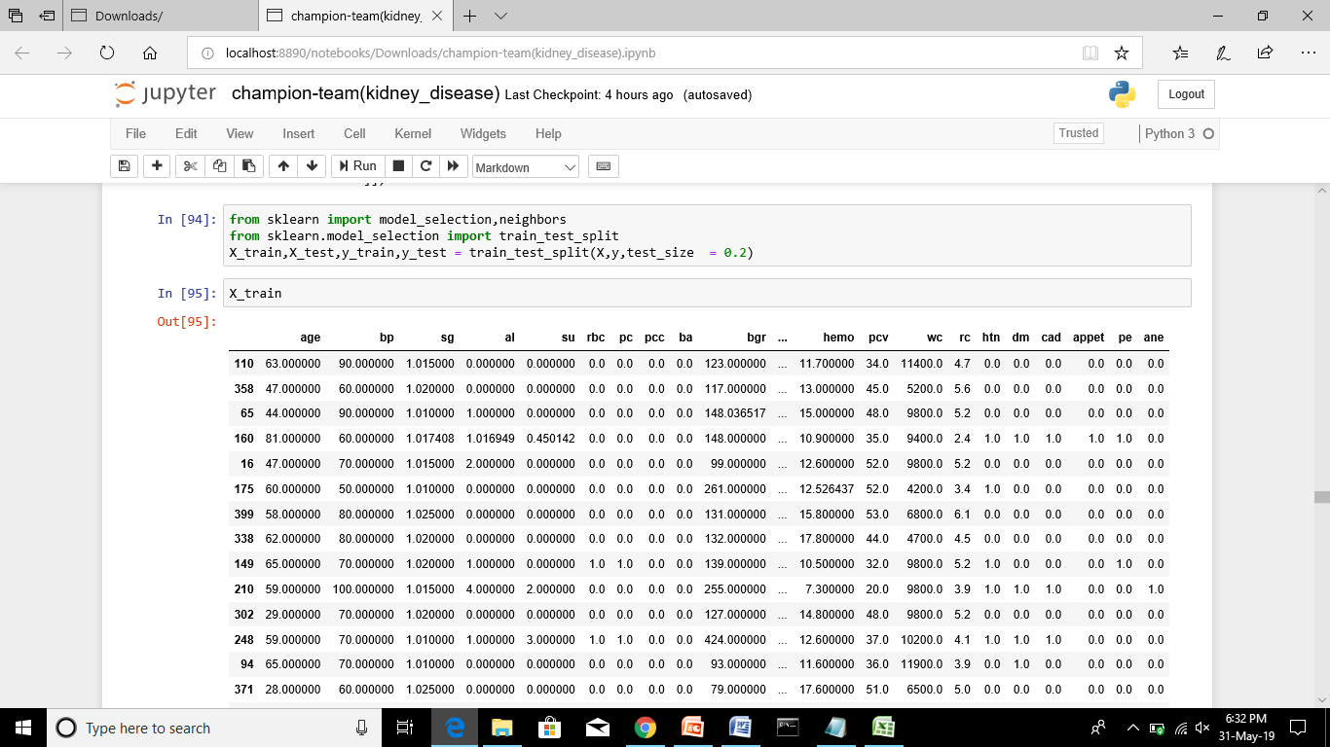
Training and Testing
The Data is Divided for Training and Testing.
80% of Data is accomodated for Training and remaining 20% is for Testing.

Slide 21
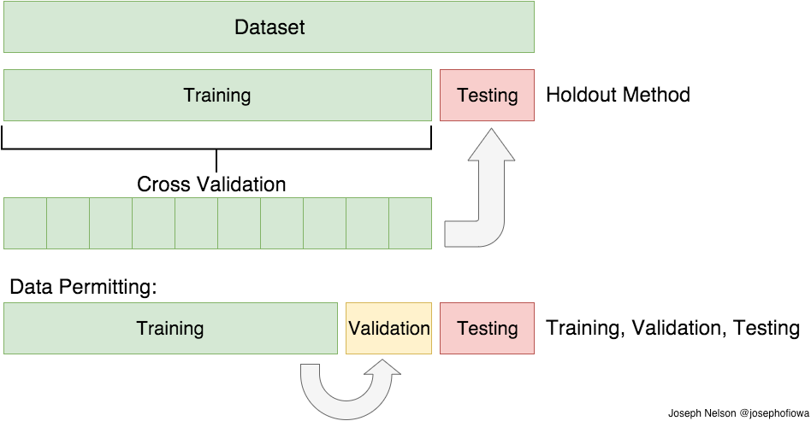

Slide 22
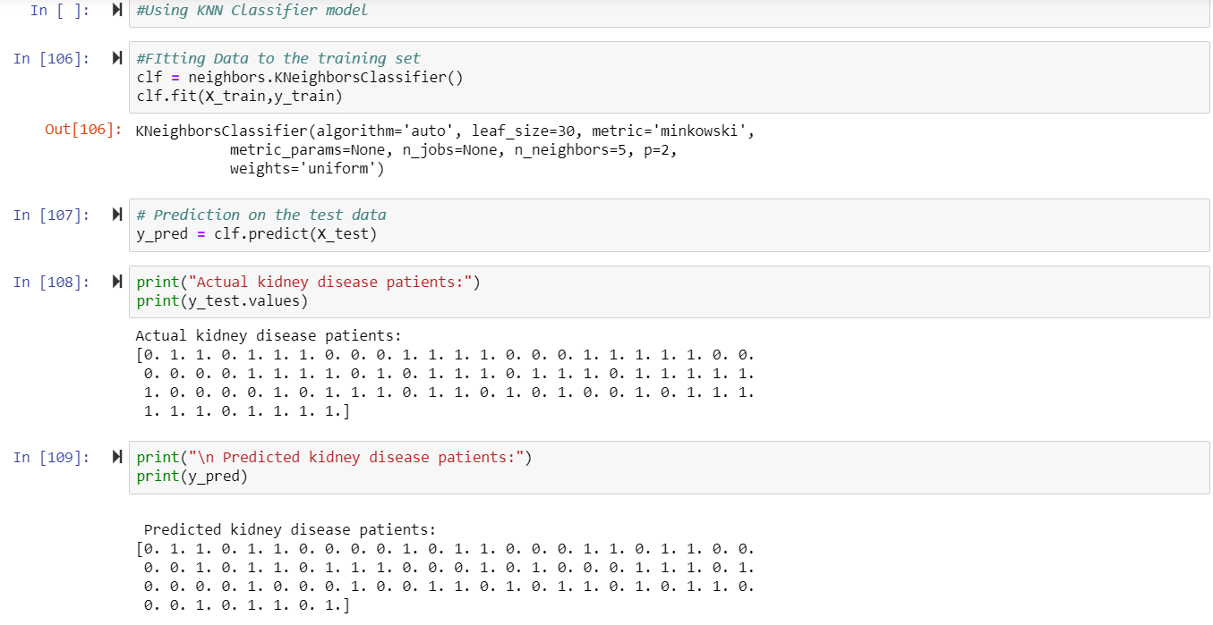
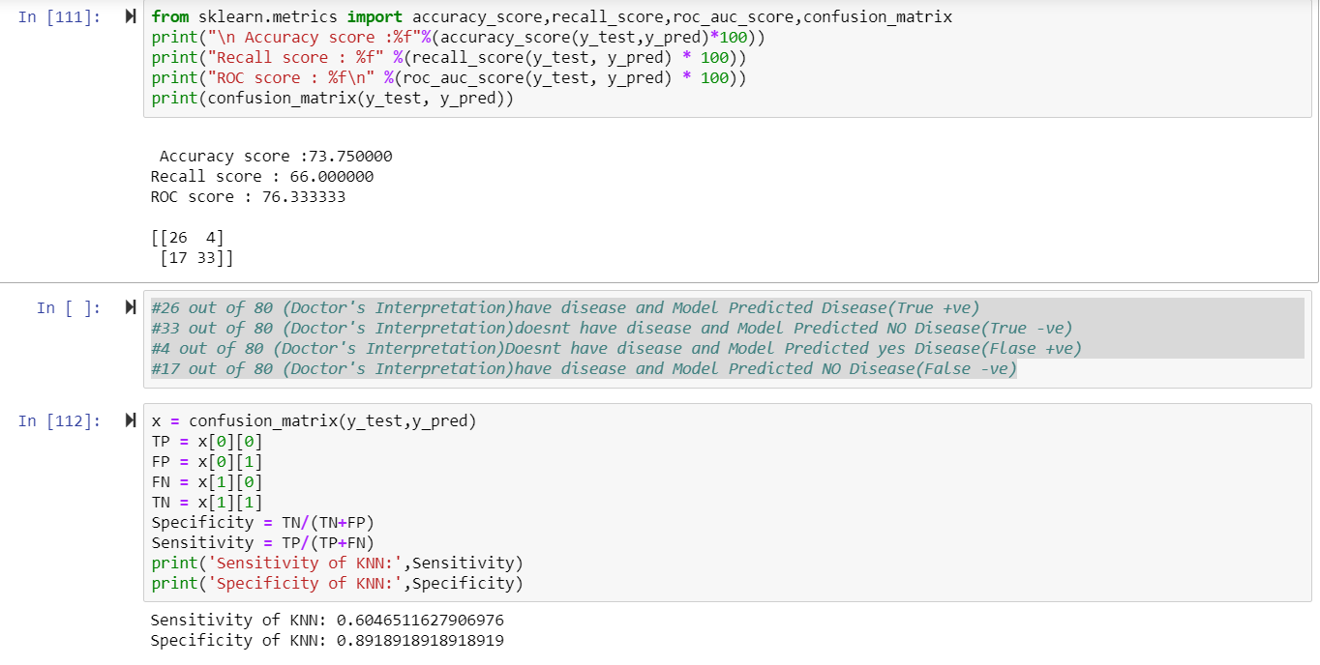
K nearest Neighbour: The model for knn is the entire training dataset. When a prediction is required for a unseen data instance, the knn algorithm will search through the training dataset for the k-most similar instances.

Slide 23
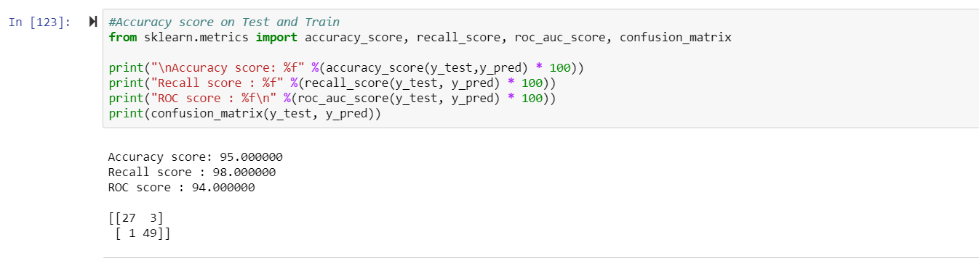
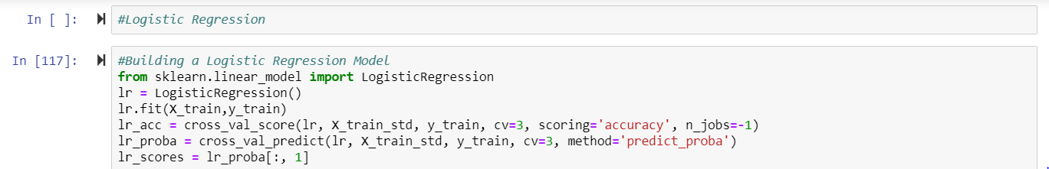
LOGISTIC REGRESSION
Logistic regression is a machine learning classification algorithm that is used to predict the probability of a categorical dependent variable

Slide 24
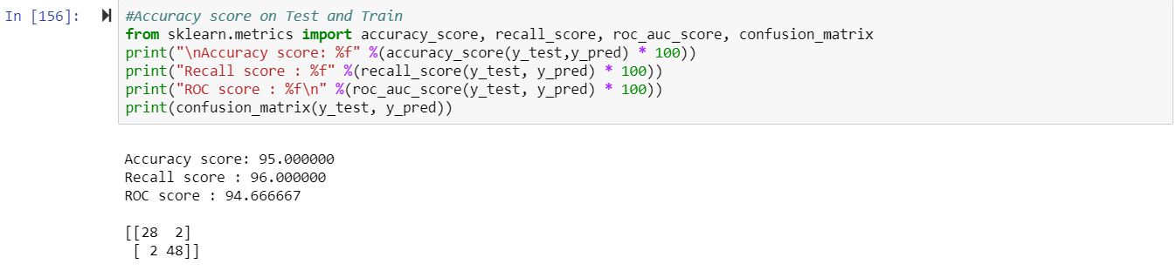
DECISION TREE CLASSIFIER
Decision trees are a non-parametric supervised learning method used for both classification and regression tasks. The goal is to create a model that predicts the value of a target variable by learning simple decision rules inferred from the data features

Slide 25
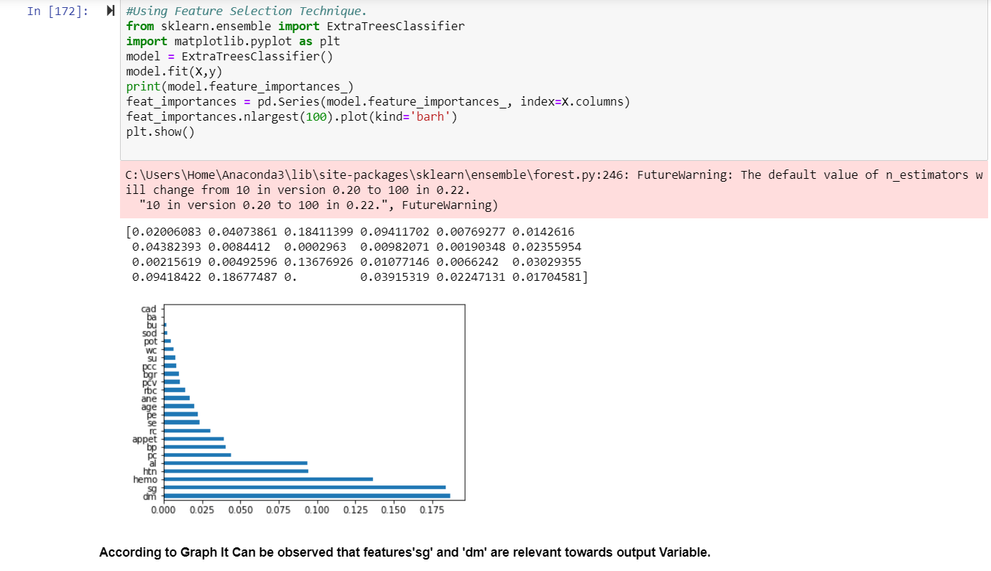
Feature Selection Technique
According to graph it can be observed that features sg,dm are affected more on classification(i.e whether ckd or notckd)

Slide 26
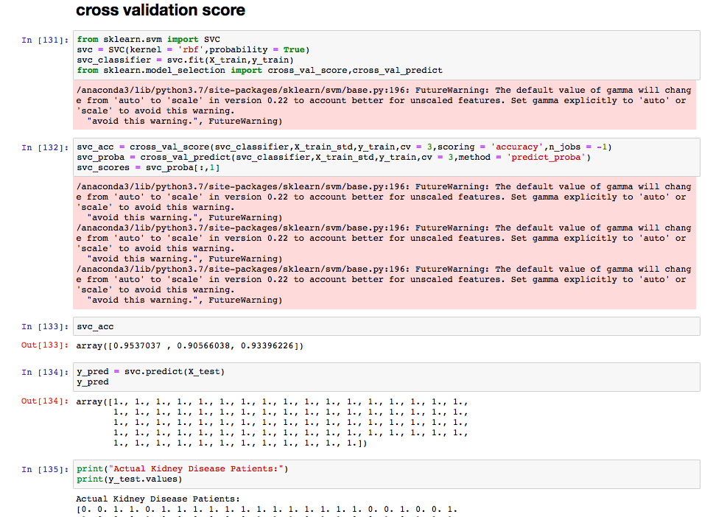
Cross validation: Extension of data split. It will done simple dataset .

Slide 27
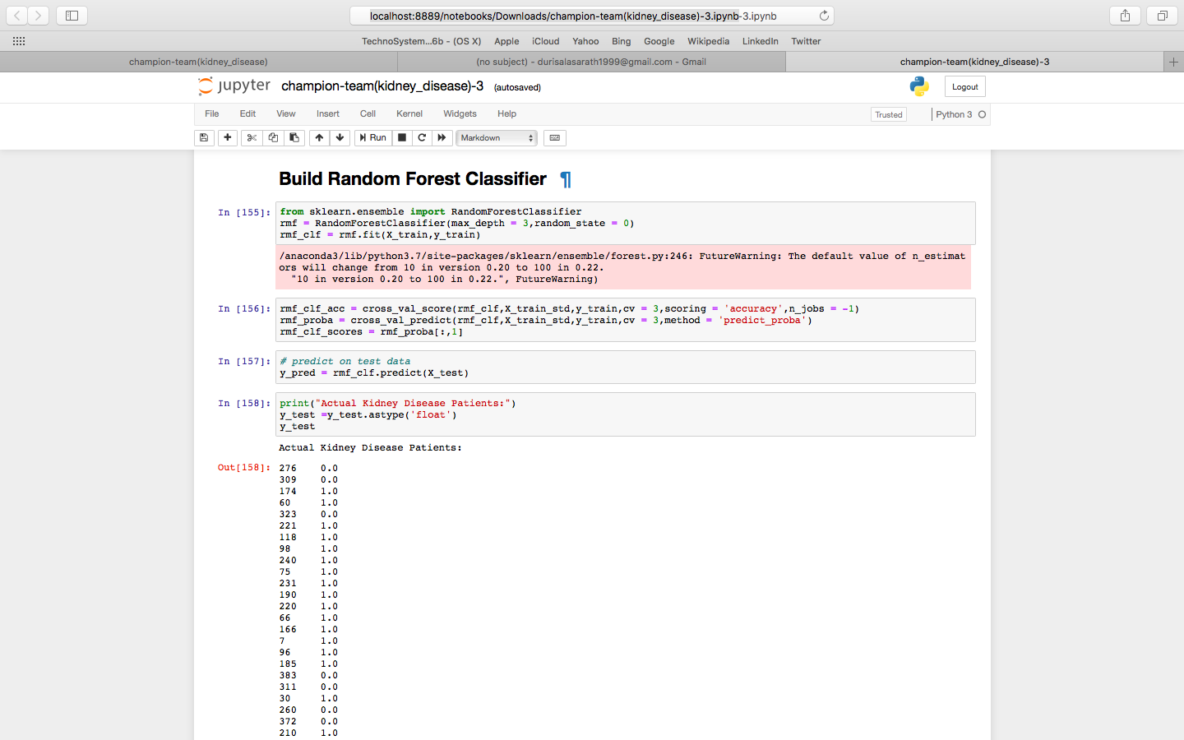
Build random forest classifier: Random forest classifier creates a set of decision trees from randomly selected subset of training set. It then aggregates the votes from different decision trees to decide the final class of the test object

Slide 28
Different Models Comparison
KNN
Logistic Regression
Accuracy:73.75
Recall Score:66
ROC Score:76.33
Confusion Matrix:TP=26,FP=4,FN=17,TN=33
Sensitivity:0.604
Specivicity:0.89
Accuracy:95%
Recall Score:98%
ROC Score:94%
Confusion Matrix:TP=27,TN=49,FP=3,FN=1
Sensitivity:0.88
Specivicity:1
SVC
Accuracy:62%
Recall Score:100%
ROC Score:50%
Confusion Matrix:TP=0,TN=50,FP=30,FN=0
Sensitivity:NaN
Specivicity:0.625

Slide 29
Decision Tree Classifier:
Random Forest Classifier:
Accuracy:98.75%
Recall Score:100%
ROC Score:98.33%
Confusion Matrix:TP=29,TN=50,FP=1,FN=0
Sensitivity:1
Specivicity:0.98
Decision Tree Classifier
Accuracy:95%
Recall Score:96%
ROC Score:94%
Confusion Matrix:TP=28,TN=48,FP=2,FN=2
Sensitivity:1
Specivicity:0.98

Slide 30
CONCLUSION:
By performing all the models , we observed that DTC, LR, RFC are better than other models.
So, we conclude that LR and RFC is best model.

Slide 31


